Slide 1
The Inverted Pendulum
ME 445 Final Project
Sri Krishna Govind Anandarao and Shardul Shrikhande

Slide 2
Inverted Pendulum Background
The inverted pendulum is a system that has a cart which is programmed to balance a pendulum.
An inverted pendulum is not a stable system and requires a constant external force for it to maintain its balance. It’s a classic controls problem and deals with the development of a system to balance the pendulum. The aim of the project is to create a control system that allows us to balance an Inverted Pendulum, by building a closed loop control system.
The project demonstrates the capability of PID Control theory, along with an introduction in interfacing motor controls, through the BLDC Drive that’s being used for this application.
System is adherently unstable since even the slightest disturbance would cause the pendulum to start falling.
An ideal controller would keep the pendulum balanced with very little change in the angle, θ, or cart displacement, q.
Limitations would be imposed based on the actual parameters of the system as well as the method for implementing a controller.
Designing a controller that is close to ideal is a challenging design problem.

Slide 3
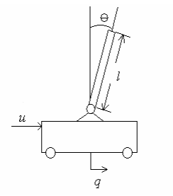
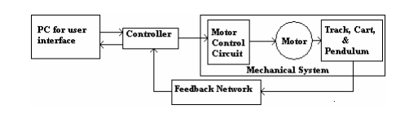
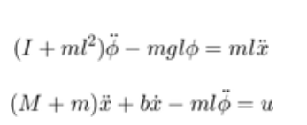
Inverted Pendulum Background
Basic diagram of a cart with a pendulum and a generic force being applied to the system.
Block Diagram of the Overall System.
Equations Governing the Motion:
Notes:
References:
1. https://people.ece.cornell.edu/land/courses/eceprojectsland/STUDENTPROJ/2004to2005/jss67/Final_Report.pdf
2. https://ctms.engin.umich.edu/CTMS/index.php?example=InvertedPendulum&section=SystemModeling

Slide 4
Objective
1. The objective of the project is to create a control system that allows us to balance an Inverted Pendulum, by building a closed loop control system.
2. The project demonstrates the capability of PID Control theory, along with an introduction in interfacing motor controls, through the BLDC Drive that’s being used for this application.
3. Project incorporated a full system design including all of the mechanical, hardware, and software design.
Subsystems: (1) the mechanical system, (2) the feedback network which includes sensors and a method to read them, and (3) a controller and its interface to the mechanical system.
Controller was implemented by an Atmel Mega2560 which varies the speed of motor.

Slide 5
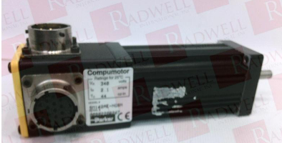
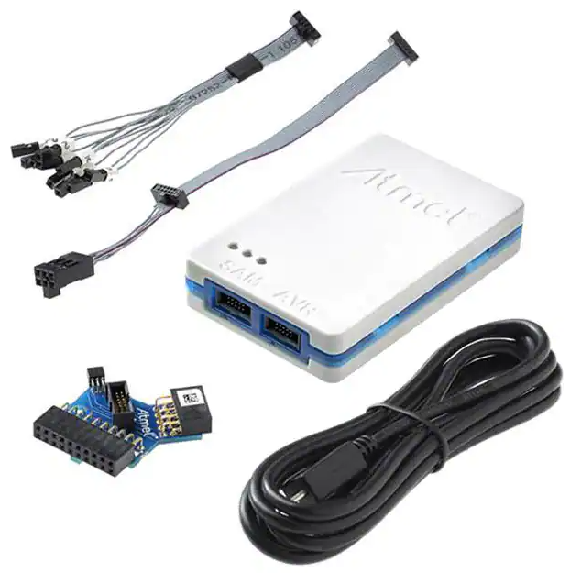
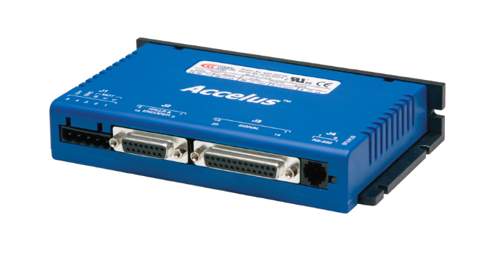
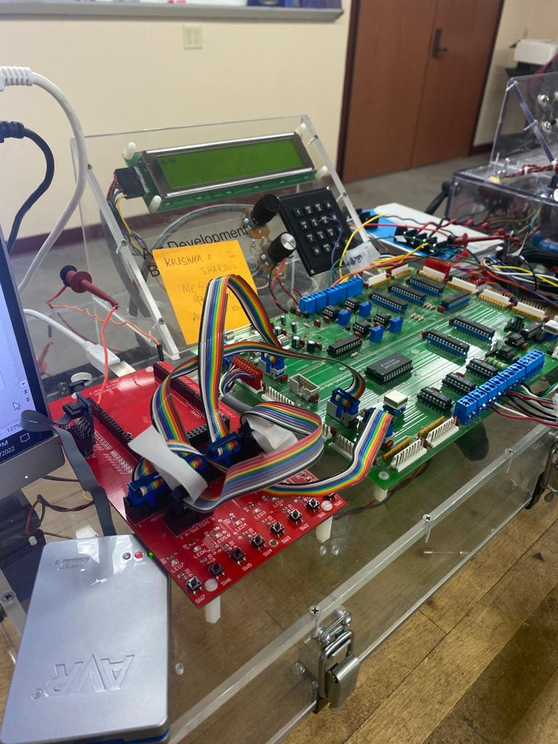
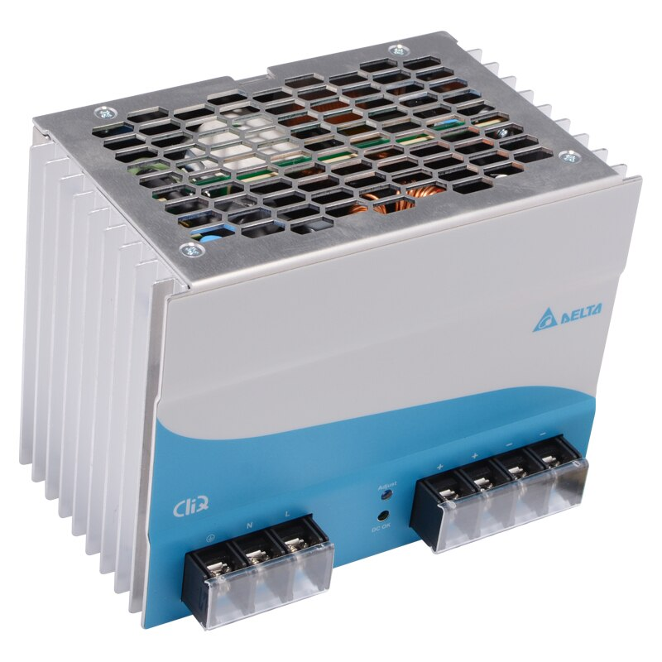
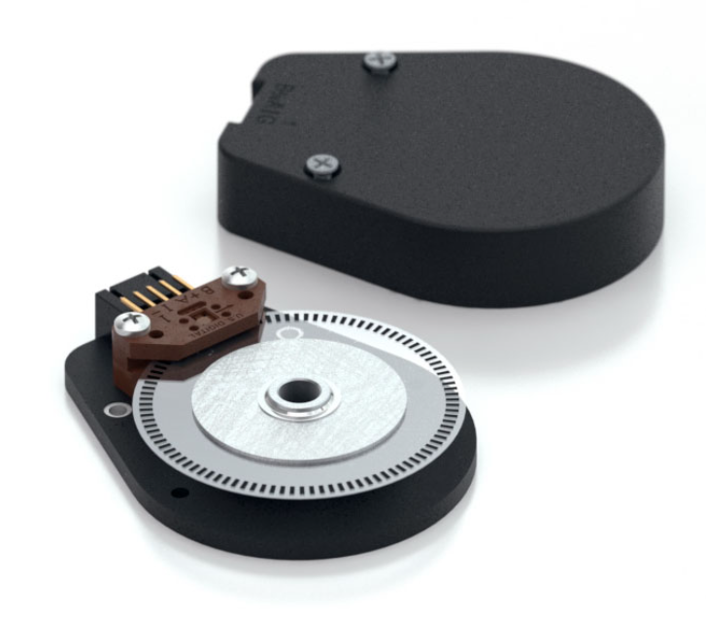
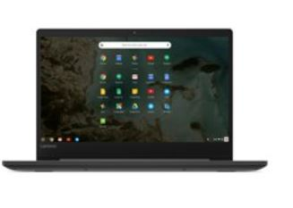
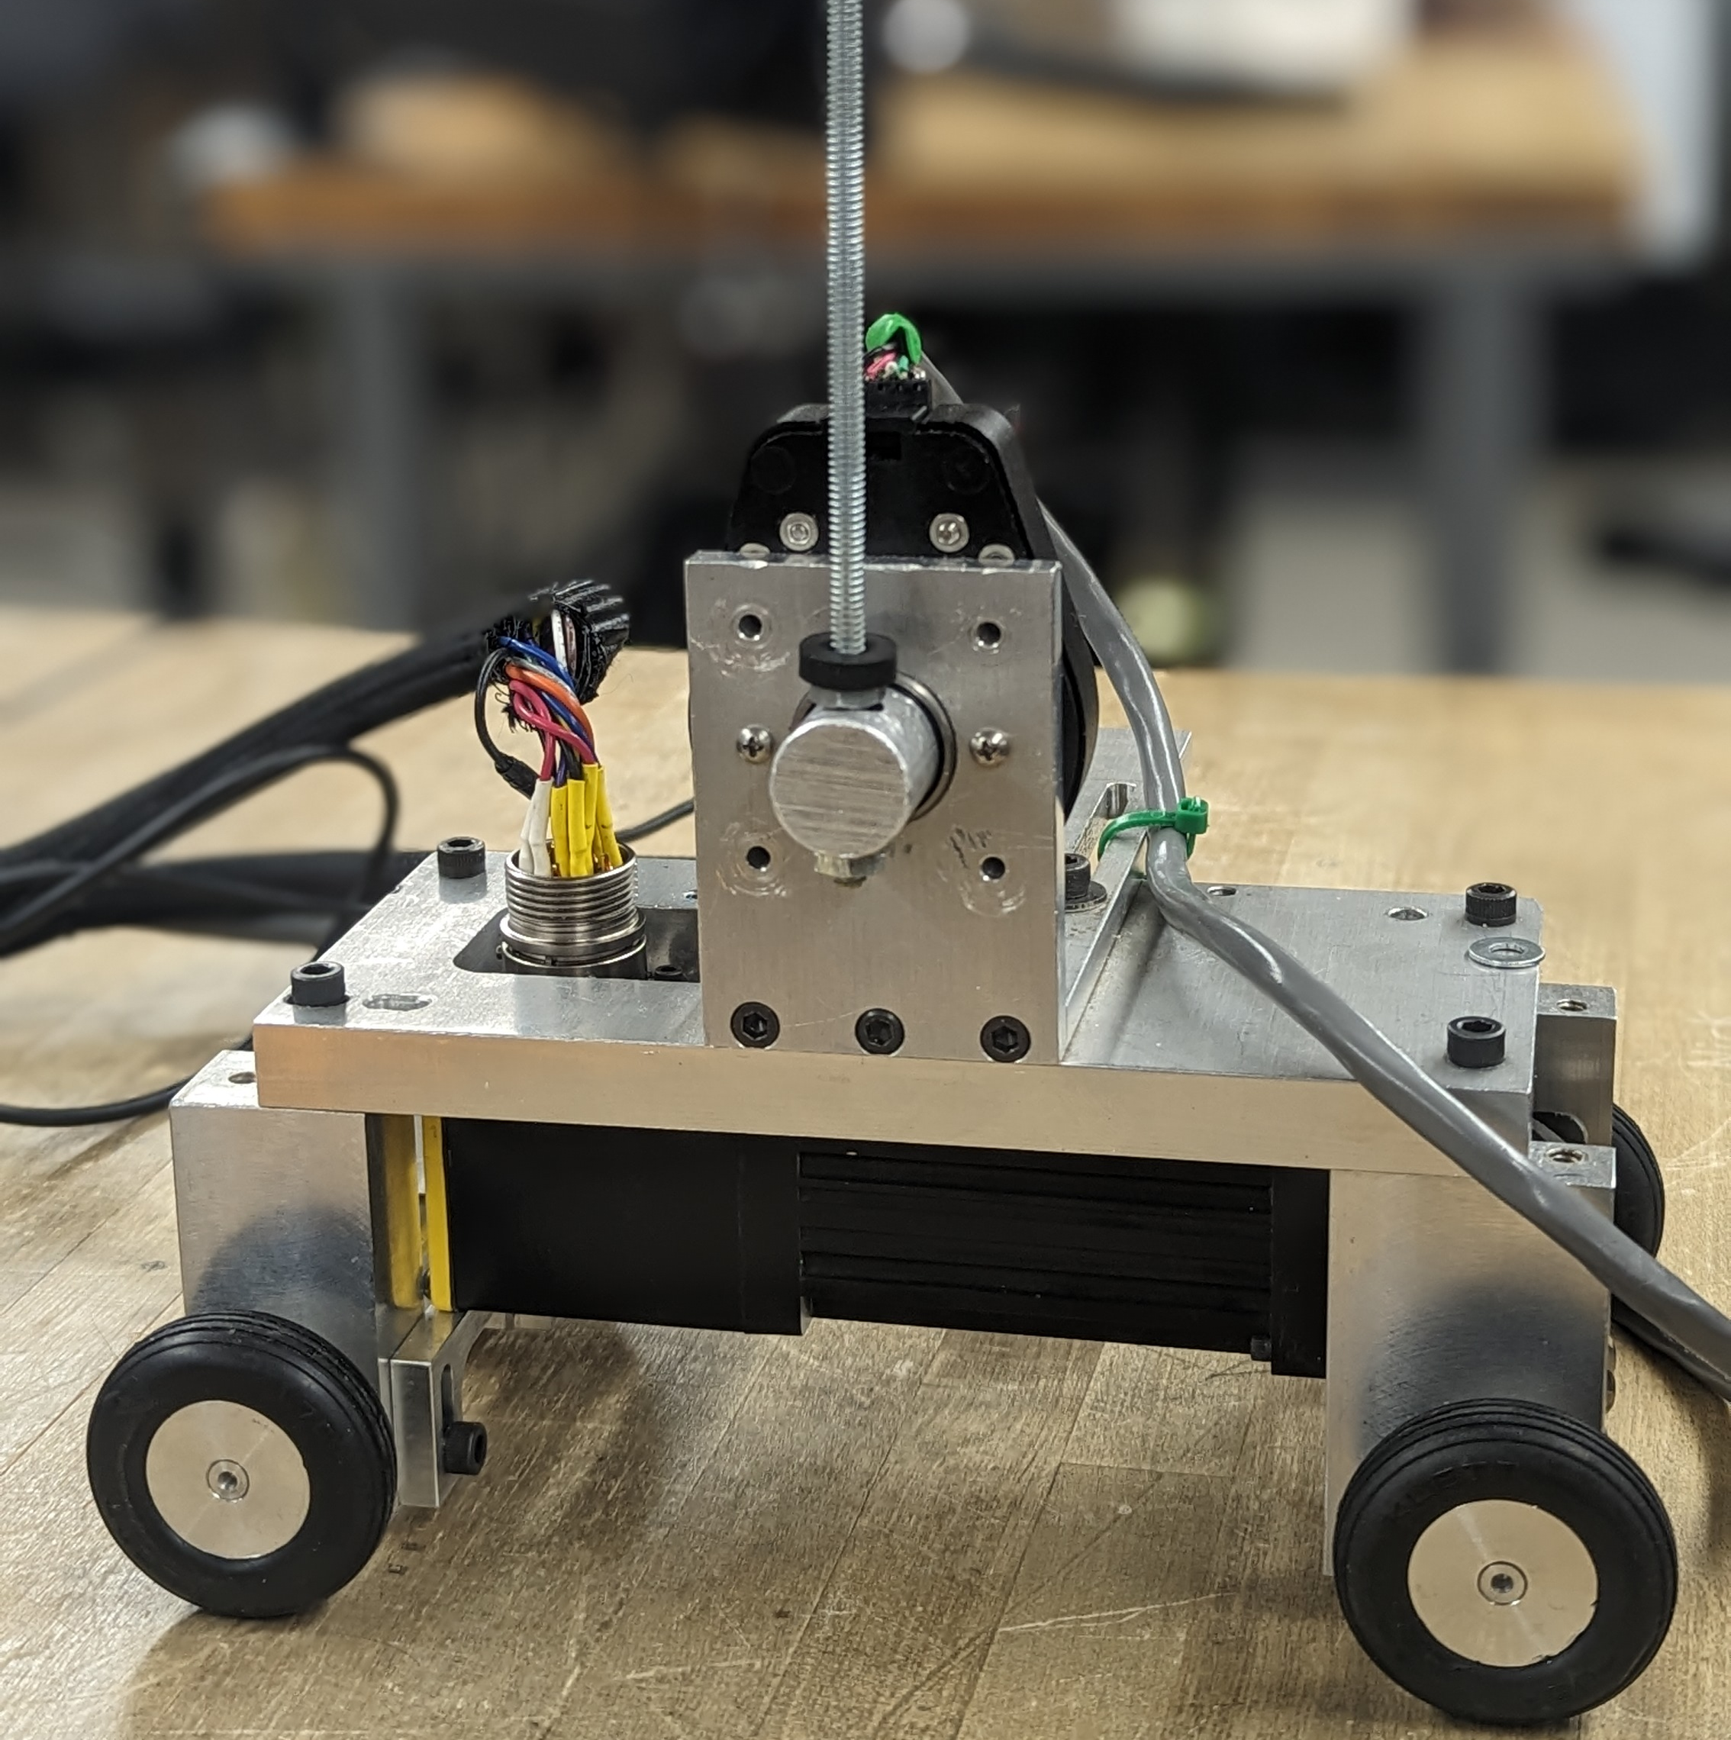
Hardware Overview
Motor
AVR JTAGICE3
Accelus ASP-090-18
Delta Eoe13010007 Power Supply
Setup
E6-4096-373-IE-S-H-D-B
Cart
PC
ME-445 Final Presentation : Anandarao - Shrikhande
Notes:
Image References:
Motor: https://www.radwell.com/en-US/Buy/PARKER/COMPUMOTOR/SM162AE-NGSN/

Slide 6
Software Overview
Copley
Microchip Studio

Slide 7

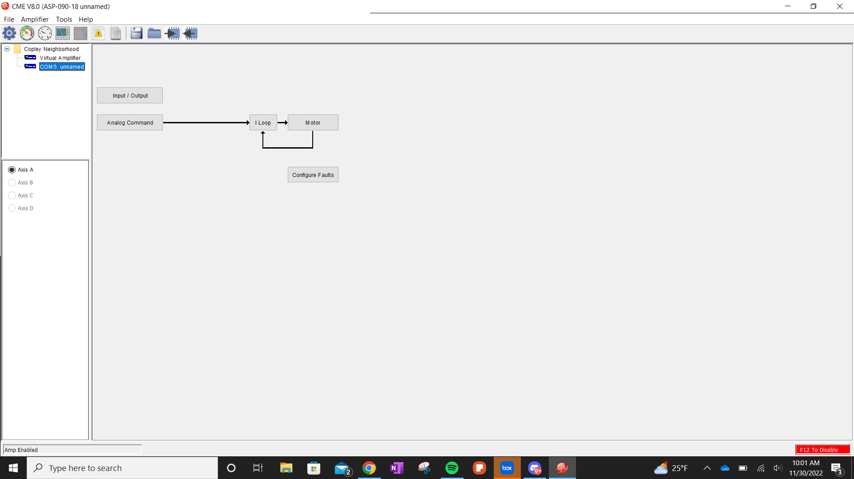
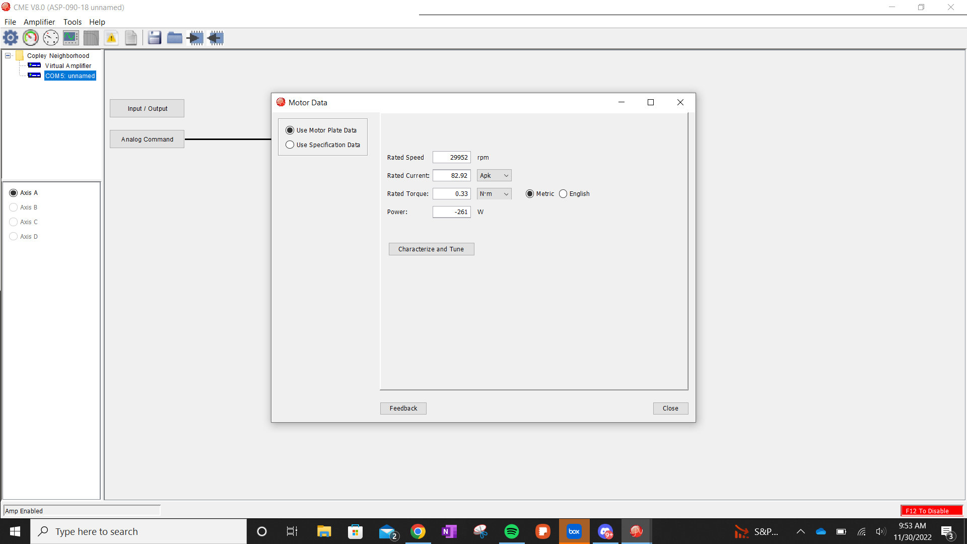
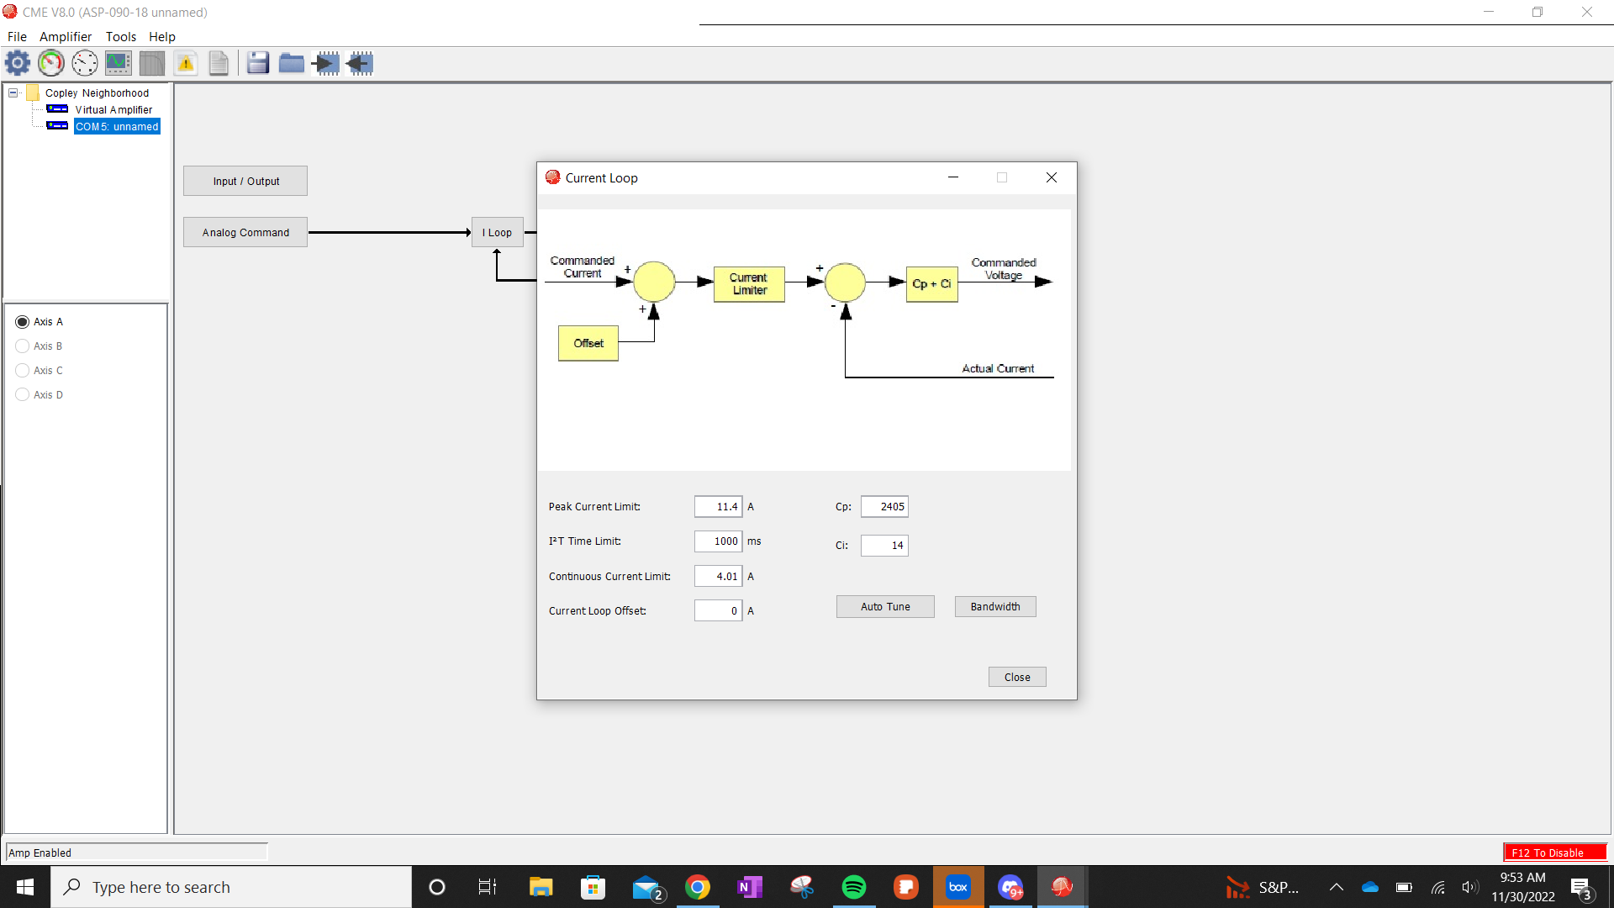
COPLEY
ME-445 Final Presentation : Anandarao - Shrikhande

Slide 8
MICROCHIP STUDIO
PD Control flow for Motion control and pendulum
C program for:
Sampling of encoder signals from channel A and B, for both Motor and Pendulum
Rollover compensation
Position estimation encoder signals.
Writing motion commands for the cart, which balances the pendulum.
ME-445 Final Presentation : Anandarao - Shrikhande

Slide 9
Labs Covered

Slide 10
Course Content Utilization
Lab 1. Passive Circuits, Filters, & Op-Amps Op-Amp Signal Conditioning:
Content from this lab is used to observe datasheets, make circuit schematics, connectors etc
Lab 3. Processors, C Programming Fundamentals Programming & Debugging Environment
Content from this lab is used to program the microcontroller in C language.
Lab 4. C Programming Fundamentals, Digital I/O, Digital Logic & Computer Math
a. Content from this lab is used to advance c programming for the microcontroller
b. Configure the Digital I/O pins for the motor controller.
Lab 5. Interrupts, timers, advanced C Concepts:
Content from these labs will be used in setting up various timers for position sampling, computing PD Difference equations, and uploading positional feedback inside the ISR
Lab 7. State Transition Diagram Techniques & Keypad/Displays or HMI/LCD
LCD will be used to display the status and position of the cart.
Lab 9. A/D, Sampling Theory, D/A, Reconstruction A/D-D/A Lab with Aliasing
Utilization of the D/A to write analog references to the BLDC Motor Controller
Lab 10. Encoders, Encoder Counters, LVDTs Encoder counter Driver lab - Encoder to LCD
Content from this lab will be applied to the Encoder next to the pendulum to monitor the position of the pendulum. There will be another encoder used to determine the position of the rotor.
Lab 12. Close Loop Position Servo Control Motor Control Lab with Data Logging
From this module we will apply the concepts of control theory.
Lab 13. Fixed point Motor Controller
Implement the controller using fixed point math.
Labs that could potentially be used
Lab 8.State Machine
Lab 11.Communication with a PC – Telemetry Logging
Total Course Utilization: 9/13: 69.2%
ME-445 Final Presentation : Anandarao - Shrikhande

Slide 11


Challenges
I/O Pins mapping
Copley software
Motor driver calibration, Not enough torque to drive the cart
Phasing errors
Future Work
SPI (Serial Peripheral Interface)
Better tune the controller for driving the cart
Better control algorithms, range limiting due to wire constraints

Slide 12
DEMO!
ME-445 Final Presentation : Anandarao - Shrikhande

Slide 13
References
Oberstar, Eric. ME 455 Mechatronics in Control & Product Realization Fall 2022. University of Wisconsin-Madison, Madison, WI, 2022.
Barnett, Cox, and O’Cull. Embedded C Programming and the Atmel AVR. Delmar Learning, Clifton Park, NY, 2003.
Ogata, Katsuhiko. Moden Control Engineering. Prentice Hall, Upper Saddle River, NJ, 2002.
Datasheets
https://copleycontrols.com/en/software/
https://ww1.microchip.com/downloads/en/devicedoc/atmel-2549-8-bit-avr-microcontroller-atmega640-1280-1281-2560-2561_datasheet.pdf
http://www.motionusa.com.s3-website-us-east-1.amazonaws.com/copley/copley_controls_Accelus_Panel.pdf
https://www.robogaia.com/uploads/6/8/0/9/6809982/ls7366r.pdf
https://cdn.usdigital.com/assets/datasheets/e6_datasheet.pdf
ME-445 Final Presentation : Anandarao - Shrikhande

Slide 14
Thank you!
Acknowledgements
Mechatronics Lab
REACH Lab

